Slide 1
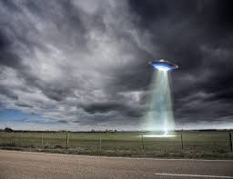
UFOs among Us
Ava Garrett, Emily Stern, & Brandy Wicker

Slide 2
Research Question:
Do UFO sightings increase over time in the contiguous U.S. by region?

Slide 3
Variables
Independent Variables (x):
Time
Location
Dependent Variable (y):
Frequency

Slide 4
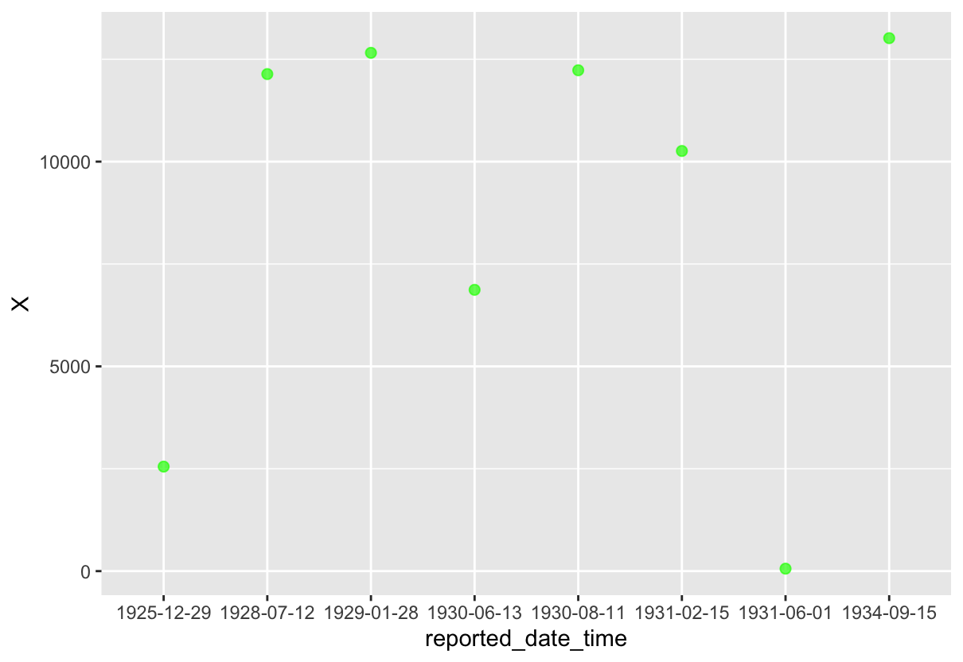

Slide 5
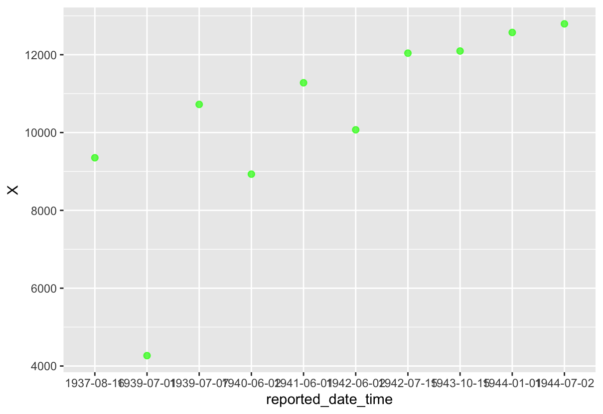

Slide 6
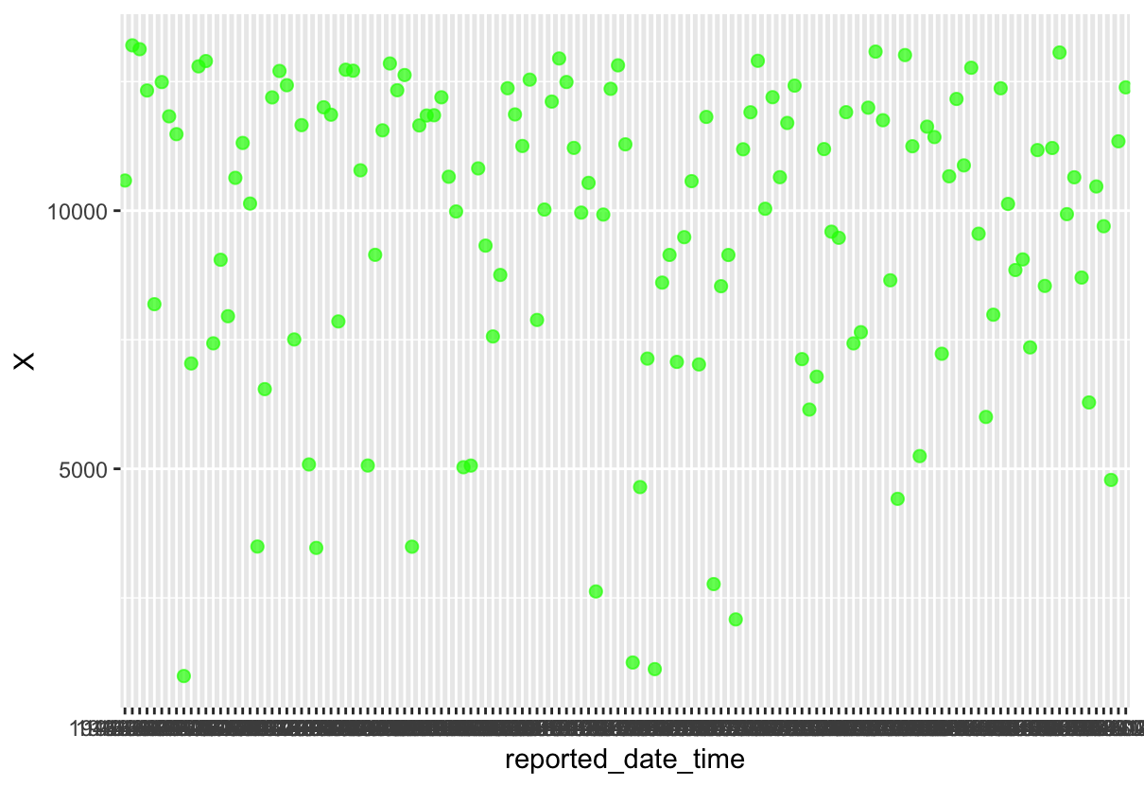

Slide 7
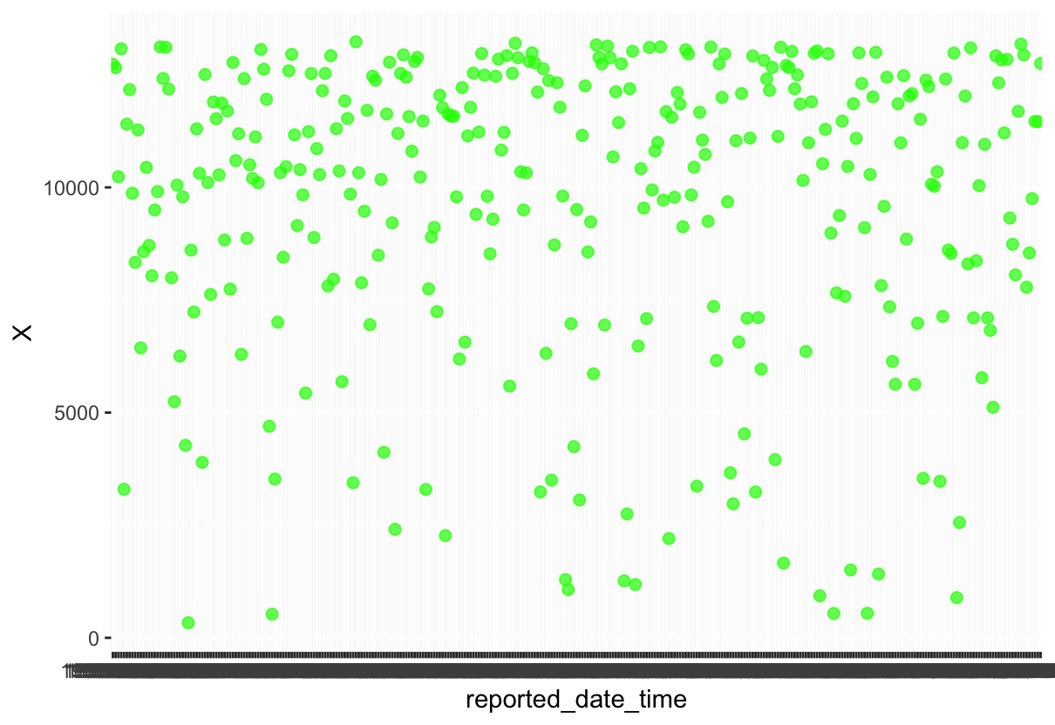

Slide 8
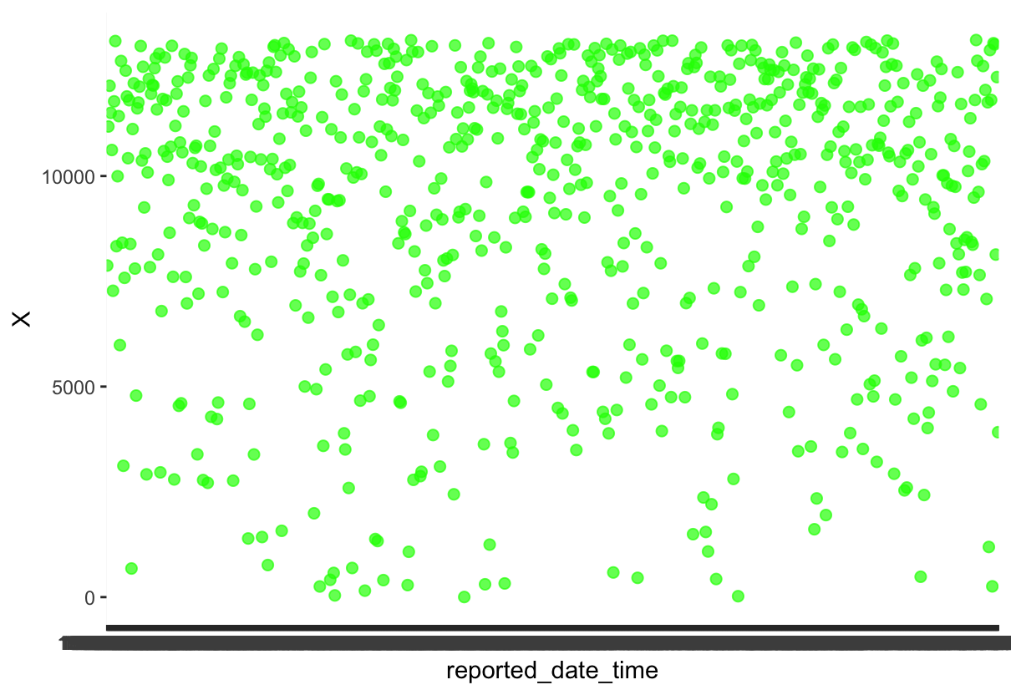

Slide 9
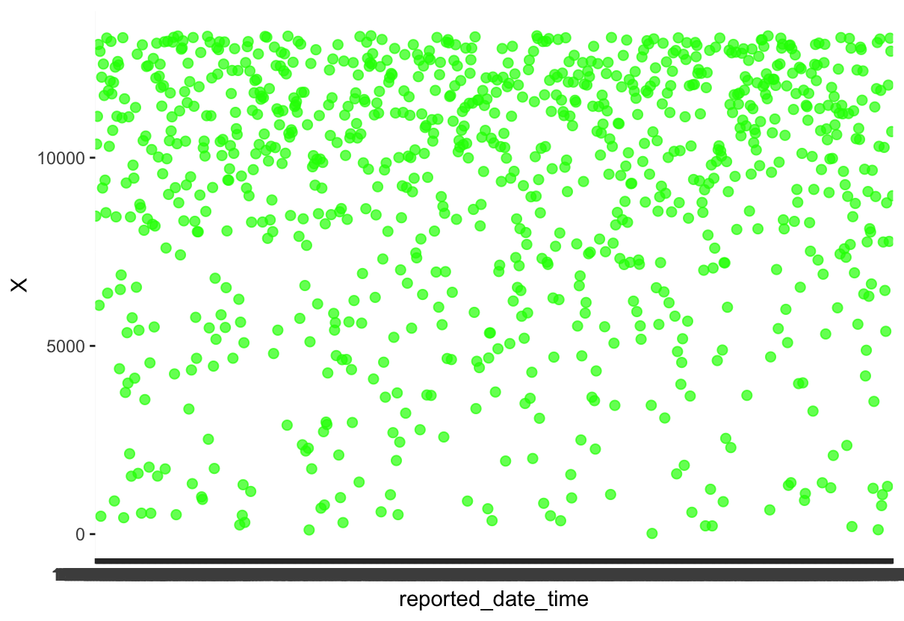

Slide 10
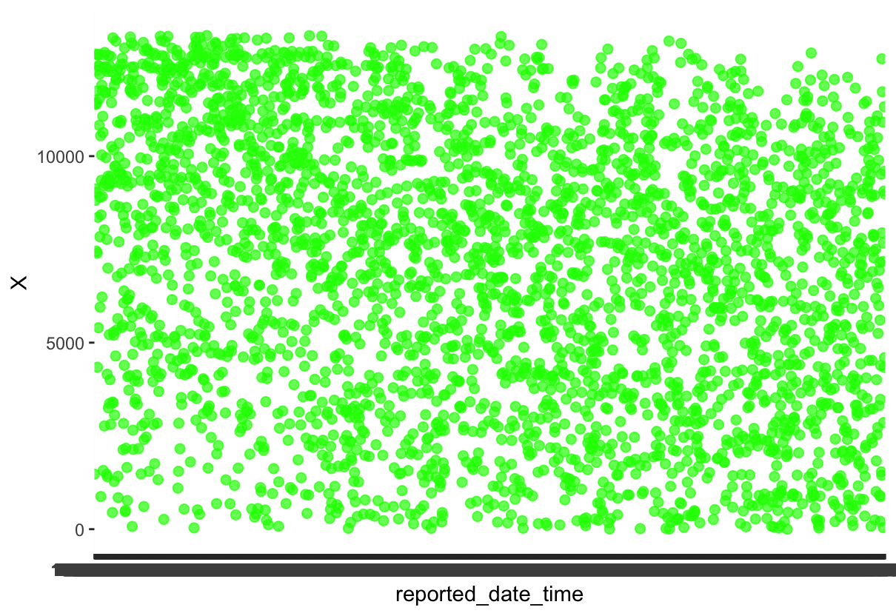

Slide 11
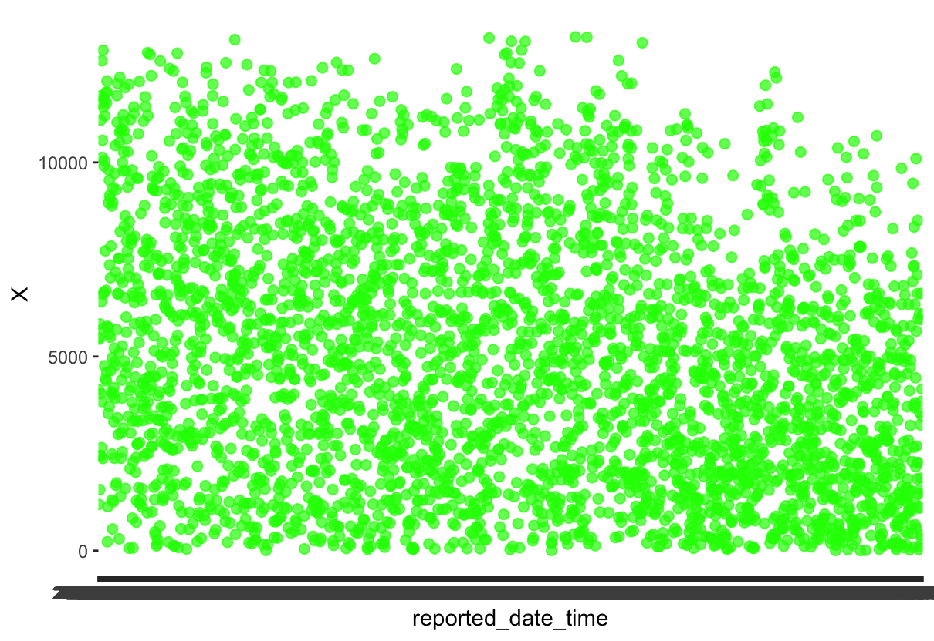

Slide 12
